Slide 1



A Python-Implemented Algorithm for Three-Dimensional Reconstruction of the Human Lumbar Spine from DICOM CT Data
Author：Wang Xuemei

Slide 2






Research Background
Research Objectives
Materials & Image Acquisition
Algorithm Pipeline
Experimental Results

Slide 3


Research Background
Lumbar degenerative diseases seriously affect people's quality of life. Although CT delivers high-resolution axial images, surgeons and biomechanical engineers still lack ready-to-use three-dimensional anatomy for planning interventions or designing patient-specific implants.
The absence of an open, rapid, training-free tool that converts standard DICOM CT into accurate 3-D STL models motivated this study. For this , this study is proposed.

Slide 4
Research Objectives
The Goal
The Innovation
Develop an open-source, training-free Python pipeline to reconstruct an STL mesh from DICOM CT in under four minutes.
Combines HU-thresholding, morphological optimisation, and marching-cubes into a single, GPU-agnostic workflow with no user interaction.

Slide 5
Materials & Image Acquisition
Validation employed an anonymised clinical CT covering L1 to S1, representing a typical acquisition protocol.
Total Slices
Field of View
320
200 mm
Slice Thickness
Matrix Size
1.0 mm
512 x 512

Slide 6
Algorithm Pipeline-Overview of Processing Stages
Data loading
Image pre-processing
Bone structure segmentation
3-D reconstruction and model export
Export to STL format
The algorithm chains five sequential blocks, all fully automatic and using empirically optimised constants for transparency and broad accessibility.

Slide 7
Experimental Results & Conclusion
The automated pipeline delivered excellent overlap with expert annotations, surpassing typical clinical thresholds.
Dice Coefficient
Intersection over Union
0.94
0.89
± 0.02
± 0.03
These values indicate high accuracy and stable performance, rivaling learning-based methods without the need for training data.

Slide 8
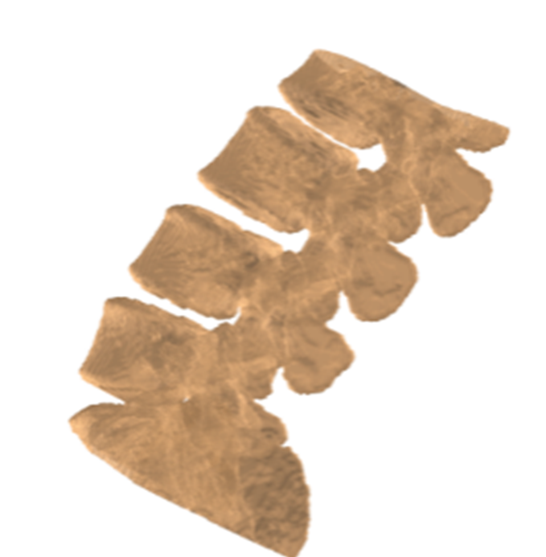
Principal results of algorithm testing
Visual of 3-D Models
Dataset | Processing time, min | STL polygons, n | File size, MB | Dice coefficient | IoU
1 | 3.0 | 245 000 | 42 | 0.93 | 0.88
2 | 3.2 | 258 000 | 46 | 0.95 | 0.90
3 | 3.1 | 251 000 | 44 | 0.94 | 0.89
Mean ± SD | 3.1 ± 0.2 | — | — | 0.94 ± 0.02 | 0.89 ± 0.03
We delivered a training-free, fully automated pipeline that converts CT DICOM into accurate 3-D STL meshes, empowering clinicians and researchers .

Slide 9



THANK YOU ！

