Slide 1



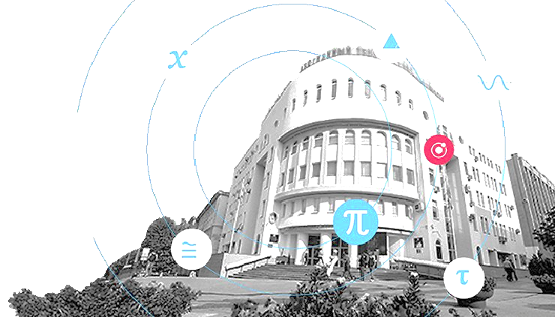
Optimization of automatic design of electrical circuits.
E. I. Kleptsova,
E. S. Kovalenko
bachelor's degree

Slide 2
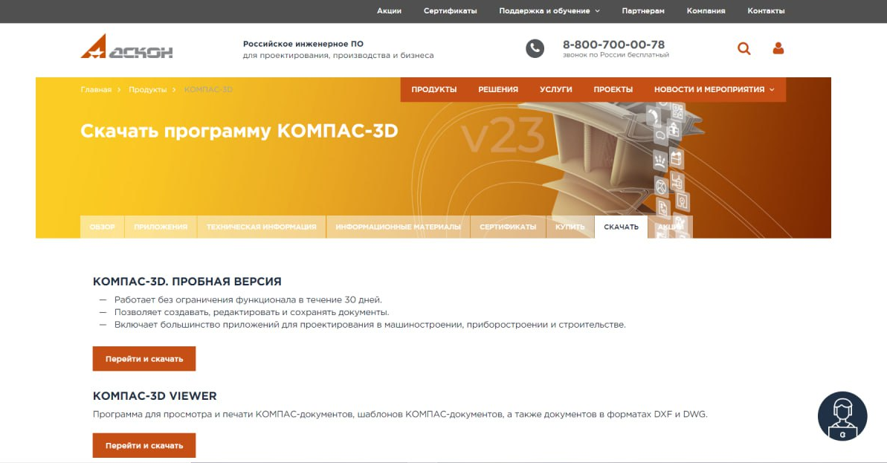
First steps to creating a project
Install the 3D compass from the official ASCON website:

Slide 3
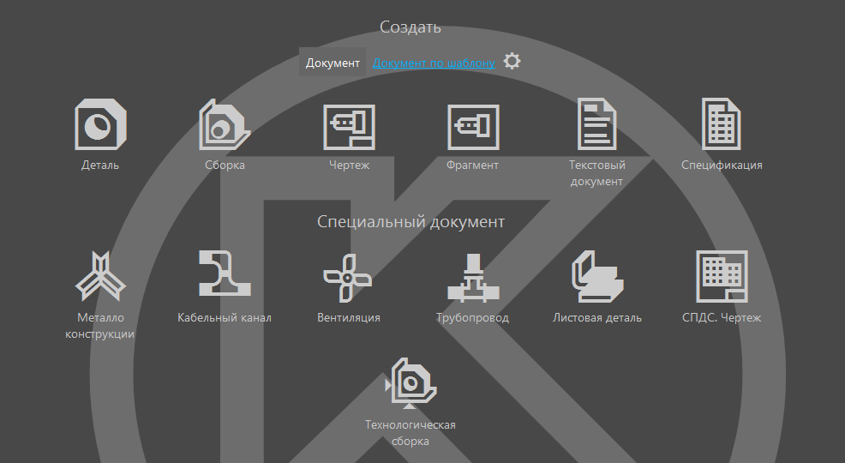
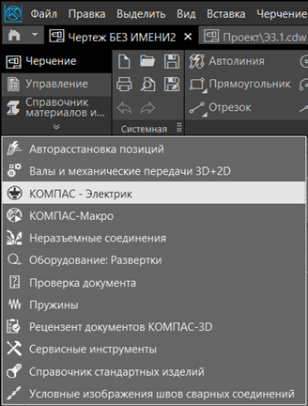
First steps to creating a project
To create an electrical circuit, select a drawing:
Below the materials directory window,
select the Electric Compass:
Notes:
План на следующий год, например. Кратко по задачам ведущим к результату.

Slide 4
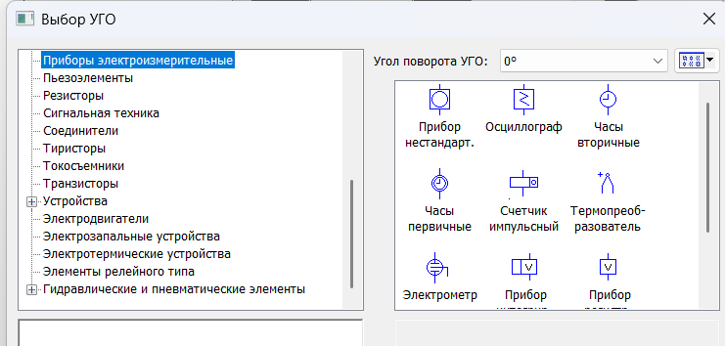
Schematic creation process
1. After creating the file, edit it for your convenience by clicking "Sheets," selecting
A3 format and horizontal orientation.
2. In the "Communication Lines" command set, select the electrical communication line and draw a rough
diagram structure.
3. In the "Objects" tab, select the UGO.
4. Depending on the required elements for the diagram, select the devices we need.
Notes:
План на следующий год, например. Кратко по задачам ведущим к результату.

Slide 5
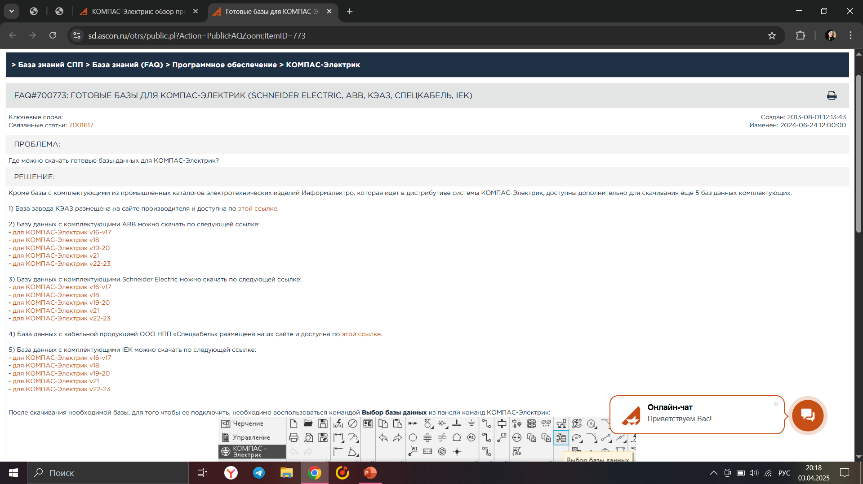
Database installation
Databases can be taken from the Ascon website:
Notes:
План на следующий год, например. Кратко по задачам ведущим к результату.

Slide 6
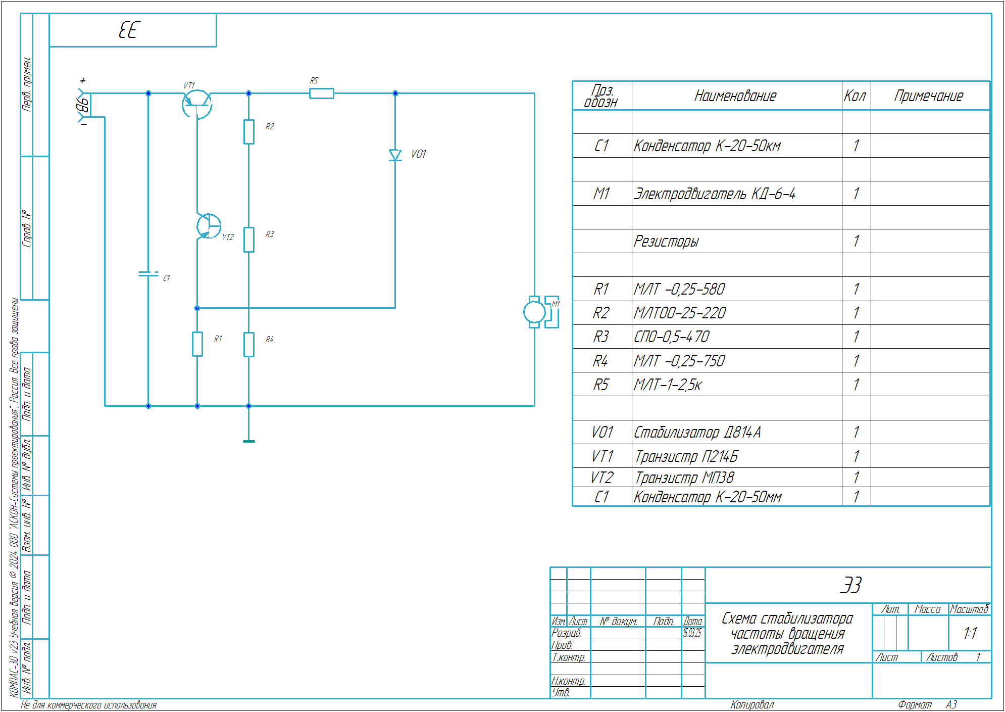
What was done according to the project
For example, using the capabilities of Kompas-Electrik, we created a circuit
for stabilizing the rotational speed of an electric motor.
Notes:
Результаты полученные на данный момент времени

Slide 7

Conclusion
1. Compass-Electrician is an effective tool for developing various electrical circuits.
2. The created step-by-step guide will be useful for students of electrical
engineering specialties when completing coursework and graduation projects.
3. Testing of the developed manual for creating electrical circuits yielded positive
results.
Notes:
Результаты полученные на данный момент времени

